Slide 1
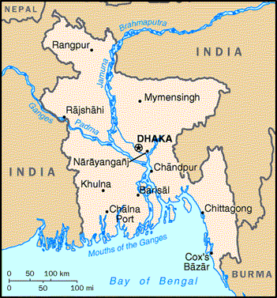
Grant Assistance for Grass-roots Human Security Projects (GGHSP)
The Project for Medical Waste Management in Rangpur District
Ｐｒｏｊｅｃｔ Ｏｕｔｌｉｎｅ
Ｐｒｏｊｅｃｔ Ｓｉｔｅ
Recipient Organization: Prism Bangladesh Foundation (PRISM)
Grant Amount: $88,626 (BDT 7,001,500)
Purpose of Grant: Equipment
Grant Contract Date: 27 March 2019
Operation Starting Date: 1 September 2019
Target Beneficiary Number:796,556 people (citizens of Rangpur City)
Project Brief: With Japanese fund support, PRISM installed equipment for medical waste management and is collecting medical wastes from all 240 Health Care Establishments in Rangpur City Corporation(RpCC) area following the MoU with RpCC. People’s health in this area was threaten by the polluted medical waste before, but now PRISM prevents the infection through this project, and all citizens of Rangpur City Corporation area (796,556 people) will be benefited from this project. (Reference: https://www.bd.emb-japan.go.jp/itpr_en/PR20190307.html)
Rangpur, Rangpur

Slide 2
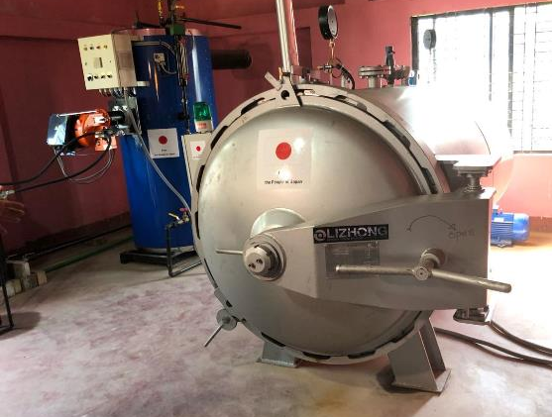
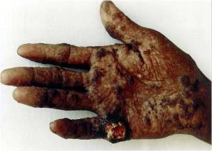
Outer Appearance
The Medical Waste Management Plant is located in the landfill area owned by Rangpur City Corporation(RpCC) in Rangpur City. Prism and RpCC are cooperating to keep the health and hygiene of the citizens of Rajshahi City Corporation area through this project.
Autoclave
Collection Vehicle
With Autoclave and Boiler, PRISM can sterilize the medical waste properly, and the waste will be dumped with the general waste.
PRISM can collect 8.62 metric tons medical waste with 2 collection vehicles per day.

Slide 3
Grant Assistance for Grass-roots Human Security Projects (GGHSP)
The Project for Procurement of medical equipment to support displaced people
from Myanmar and host community in Cox’s Bazar
Ｐｒｏｊｅｃｔ Ｏｕｔｌｉｎｅ
Ｐｒｏｊｅｃｔ Ｓｉｔｅ
Recipient Organization: Community Initiative Society (CIS)
Grant Amount: $42,715 (BDT 3,374,524 )
Purpose of Grant: Equipment
Grant Contract Date: 7 March 2019
Operation Starting Date: 1 May 2019
Target Beneficiary Number: 45,470 people living in Camp 15 Project Brief: CIS installed medical equipment in their clinic at the refugee camp in Cox’s Bazar with the support of GGHSP. It is contributing for the improvement of medical environment of the target area including Obs & Gynae, child health care and emergency care. (Reference:https://www.bd.emb-japan.go.jp/itpr_en/PR20190307.html)
Cox’s Bazar, Chittagong

Slide 4
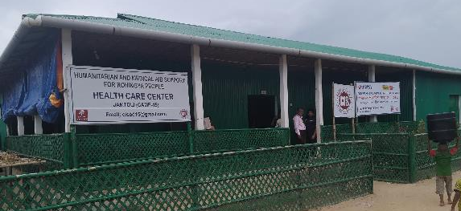
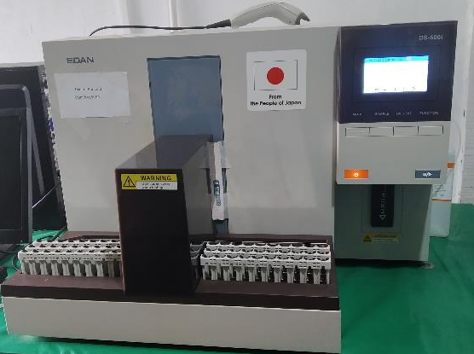
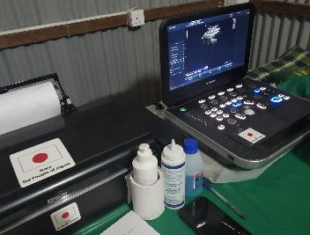
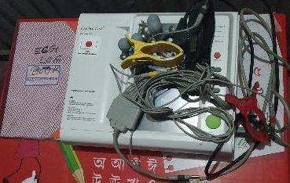
Outer Appearance
This clinic is located at Camp 15, Jamtoli area, Ukhiya Upazila. Many people living in the remote areas of Camp 15 needed to walk around 1~3 hours to have access to health facilities until CIS constructed the clinic for providing stationary and mobile clinical servicecs.
Hematology Analyzer
Ultrasound machine, ECG
Medical check-up by ECG machine is one of the popular diagnosis for checking the status of their heart. Ultrasound machine can provide pregnancy test, ANC and PNC service etc.
Haematology analyser is used for the general diagnosis of patients who have the symptom of anaemia, infectious diseases etc.

Slide 5
Grant Assistance for Grass-roots Human Security Projects (GGHSP)
The Project for the Establishment of a Community Radio Station in Gaibandha
Ｐｒｏｊｅｃｔ Ｏｕｔｌｉｎｅ
Ｐｒｏｊｅｃｔ Ｓｉｔｅ
Recipient Organization: SKS Foundation
Grant Amount: $70,692 (BDT 54,36,214.80)
Purpose of Grant: Construction & Equipment
Grant Contract Date: 29 March 2015
Operation Starting Date: 01 April 2016
Target Beneficiary Number: 1,040,813 residents of Gaibandha
Project Brief:
With the community radio station established through the Japanese assistance, SKS foundation is broadcasting information programs on disaster, education, health, culture and alike with a view to decreasing the natural disaster damages and ensuring sustainable community development in “Char” areas of Gaibandha.
(Reference: http://www.bd.emb-japan.go.jp/en/news/PR20150329.pdf)
Radhakrishnapur, Gaibandha

Slide 6
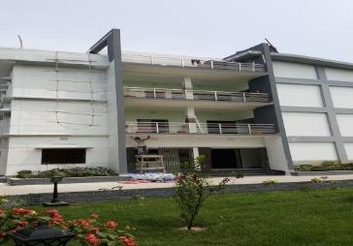
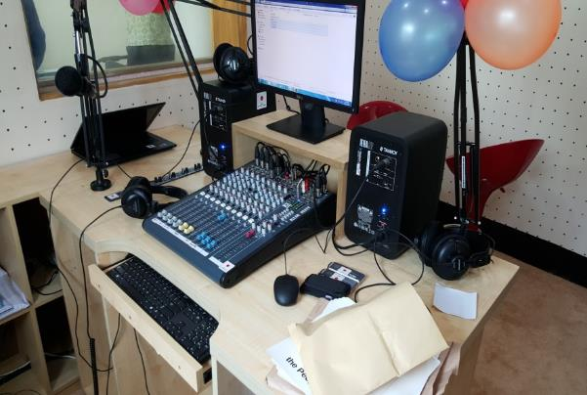
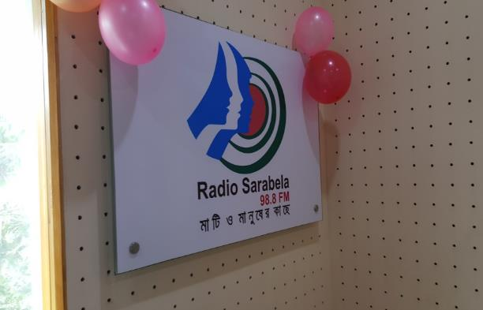
Outer Appearance
The facility is located in Gaibandha Sadar Upazilla. With a capacity of 17 KM radius frequency, it is able to cover the “Char” areas of the region.
Console Panel
Radio Sarabela 98.8 FM
Modern broadcasting equipment have been installed in this facility with a view to provide quality listening experience.
Radio Sarabela is expected to benefit at least 1,040,813 residents of the region per year.

Slide 7
Grant Assistance for Grass-roots Human Security Projects (GGHSP)
The Project for the Construction of Farmers Training Center in Dhamrai
Ｐｒｏｊｅｃｔ Ｏｕｔｌｉｎｅ
Ｐｒｏｊｅｃｔ Ｓｉｔｅ
Recipient Organization: Society for Development Initiatives (SDI)
Grant Amount: $121,623 (BDT 91,21,748.00 )
Purpose of Grant: Construction and Equipment
Grant Contract Date: 13 March 2014
Operation Starting Date: 02 May 2016
Target Beneficiary Number: 1,332 poor farmers
Project Brief:
With Japanese fund SDI constructed a farmers’ training centre for small and middle size farmers with a view to promote organic farming and to improve farmers’ agricultural productivity capacity that would increase their income and ensure food safety.
(Reference: http://www.bd.emb-japan.go.jp/en/news/gghspceremony20140313.html)
Dhamrai, Savar

Slide 8
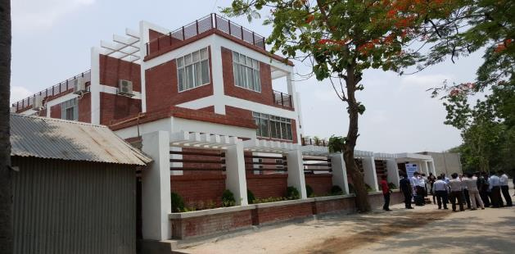
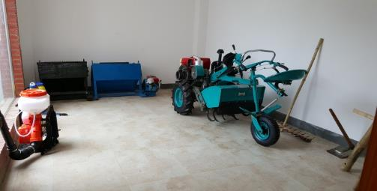
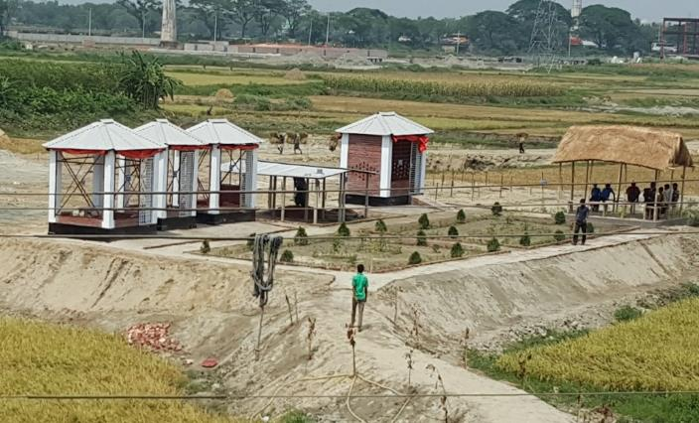
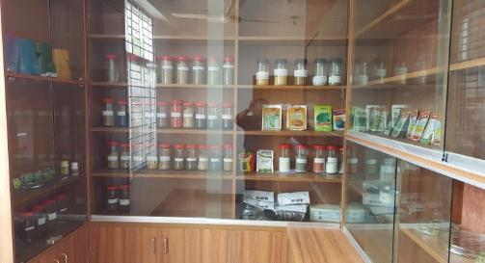
Outer Appearance
This facility is easily accessible from Dhaka-Savar highway. Majority of the inhabitants of the area is engaged in agricultural production. Therefore, this facility would be able to provide them with training on modern methods for organic farming.
Agricultural Equipment and Seeds
Demonstration Plots
Demo plots are providing practical knowledge on rice production, poultry, animal farming, vermicomposting and alike.
This project is expected to benefit 1332 farmers per year.

Slide 9
Grant Assistance for Grass-roots Human Security Projects (GGHSP)
The Project for the Establishment of District Food Processing Center
for Rural Women Development in Tala
Ｐｒｏｊｅｃｔ Ｏｕｔｌｉｎｅ
Ｐｒｏｊｅｃｔ Ｓｉｔｅ
Recipient Organization: Women Job Creation Center (WJCC)
Grant Amount: $122,906 (BDT 9,832,510)
Purpose of Grant: Construction＆Equipment
Grant Contract Date: 21 March 2013
Operation Starting Date: 1 April 2015
Target Beneficiary Number: 420 Poor female farmers
Project Brief: With GGHSP fund, WJCC constructed a building and installed the equipment for food processing training for poor women. WJCC organizes women's group for managing the facilities, keeping quality of the products and promoting the sales. This project is contributing to the food security and increased income of the local people. (Reference: https://www.bd.emb-japan.go.jp/en/news/childhospital20130321.html )
Satkhira, Khulna

Slide 10
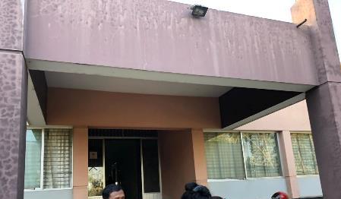
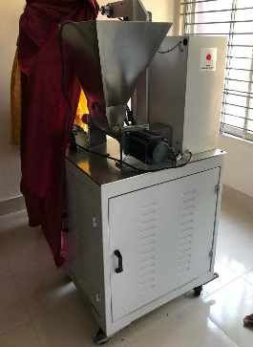
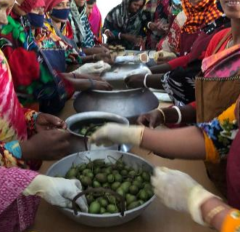
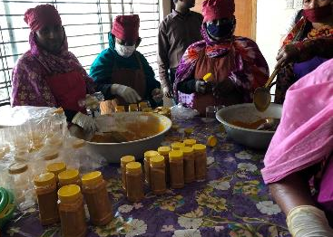
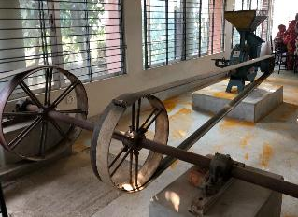
Outer Appearance
The food processing center is located at Tala Upazila, Satkhira, Khulna. It is adjacent to the main road, so it is easily accessible by local women.
Turmeric Mill and Packing Machine
Food Processing
Local female farmers can sell their raw materials to the centre, and also process them to produce turmeric powder, pickles etc. by these equipment.
Women’s group manage the center in shifts, and any member who wants to work can come with their children to the center.

